Slide 1
SQL – Part 2
Functions

Slide 2
Agenda
Sql – Aggregate Functions (Count, Sum, Average,
min, max)
Sql – Calculation Function (ABS, Round, Power, Sqrt)
Sql – Character Functions (Substring , Upper/Lower,
Replace etc.)
Date & Time
Conversion Functions (Cast, Convert)
General Functions (IsNull, Top)

Slide 3


Aggregate functions (count)
Also known as Group functions.
Returns the value based on field value.
Note: COUNT applies to duplicates, unless otherwise stated
Count Function:
Returns the number of items (records) in specific field:
For example : if we want to know how many employees are in
Employee Table we can write:

Slide 4


Aggregate functions (count)
If we want to know how many employees have a value in Region
Field we can write:
And we can combine between count function with other reserved
Words such as distinct.
For example when we
want to know how many
Employees there are from
Different area :
SELECT Count(DISTINCT region)
FROM Employees

Slide 5


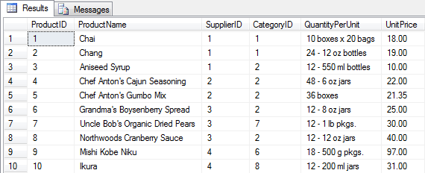
Aggregate functions (sum)
Sum Function:
Returns the summary values in group or in Field
For example : if we want to calculate the summary of all products
at ‘UnitPrice’ field in Products Table we can write:

Slide 6
Aggregate functions (sum)
If I have Purchase table:
Product | Date | Price | Quantity
Bagel | 10/21 | 1 | 20
Banana | 10/3 | 0.5 | 10
Banana | 10/10 | 1 | 10
Bagel | 10/25 | 1.50 | 20
SELECT Sum(price * quantity)
FROM Purchase
SELECT Sum(price * quantity)
FROM Purchase
WHERE product = ‘bagel’
50 (= 20+30)

Slide 7
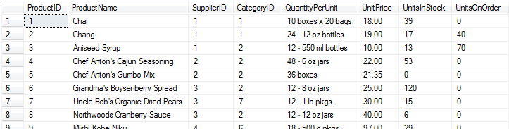


Aggregation (average)
Average (AVG) Function:
Returns the average value of the value of field/group.
For example : if we want to calculate the average of all products
at ‘UnitsInStock’ field in Products Table we can write:
Note: works only on numeric field, and avoiding nulls

Slide 8
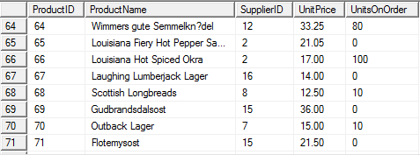


Aggregation (Max)
Max Function:
Returns the maximum value in field. Works on numeric or
Character fields.
For example : if we want to know which is the largest order item

Slide 9


Aggregation (Min)
Min Function:
Returns the minimum value in the field. Works on numeric or
Character fields.
For example : if we want to know which is the largest order item

Slide 10
Calculation functions
ABS Function: Returns the absolute value in the field.
example:
Select ABS(A) as ‘absolute number’
From Numbers
Round Function:
Select UnitPrice, ROUND (UnitPrice, 0) AS 'ROUND'
From Products
Where ProductID IN (5,14,15,18)
Sqrt Function:
Select UnitPrice, SQRT (UnitPrice) AS 'SQRT' From Products

Slide 11





Character functions
Substring Function: Syntax: SUBSTR(STR, start, length)
Returns a part of the string.
LEN() – returns the string length
Example: Select FirstName, LEN(FirstName) From Employees
Where employeeID = 1

Slide 12
Character functions
Replace Function: Syntax: REPLACE(str, sub_s1,sub_s2)
Replace specific character in string by another character
Select Replace (‘Gadi Rosen’, ‘d’, ‘b’) Gabi Rosen
Charindex Function :
Syntax: CHARINDEX(substring, string, start)
Example: Select Charindex(‘d’, ‘Gadi Rosen’)
Search for ‘d’ in string ‘Gadi Rosen’, and return position

Slide 13
Date / time
There are 3 standard types of date / time :
DATE, TIME , DATETIME
DATE – Stores the date in date format : YYYY-MM-DD
TIME – Stores the time in time Format: HH:MI:SS.nn(0-7)
DateTime – Stores DateTime in Format: YYYY-MM-DD HH:MI:SS.nn
SmallDateTime – Stores short range perioud of DateTime
Date from : 1900-01-01 till : 2079-06-06
Time from : 00:00:00 till : 23:59:59.999

Slide 14
Date / time
DateTime Functions:
GetDate() – Returns Computer’s DateTime
Example: SELECT GETDATE() AS CurrentDate
DateAdd() – Adding days/ months/ years to certain date
Example: SELECT BirthDate,
DATEADD (yy,2,BirthDate) AS 'New Birthdate'
FROM Employees
DateDiff() – Returns the difference between one date to another:
Example : SELECT birthdate, hiredate,
DATEDIFF (yy,birthdate,hiredate) AS 'Hired at age'
FROM Employees

Slide 15
Date / time
DateTime Functions:
Day() – Returns the Day in Month (between 1-31) of certain Date
Example: SELECT birthdate, Day (birthdate) AS 'Born in day'
FROM Employees
Month() – Returns the Month of certain Date
Example: SELECT birthdate, Month(birthdate) AS 'Born in day'
FROM Employees
DateDiff() – Returns the Year of certain Date
Example : SELECT birthdate, Year(birthdate) AS 'Born in day'
FROM Employees

Slide 16
Conversion function
STR() - To convert from data type int to string:
For example: to convert employeeID from int to string in Employee Table:
Example: SELECT EmployeeID, STR (EmployeeID) AS EmpString
FROM Employees
Cast/Convert – Convert from one data type to another (Cast is an ANSI Function)
For example: SELECT CAST (10.6496 AS int) – returns 10
SELECT CONVERT (int, 3.14765) – returns 3
Cast/Convert for Date:
CAST (GETDATE () AS char(12)) AS String
Returns: 10:46:31.737 2009-07-16 => Jul 16 2009

Slide 17
General function
IsNull() – replace all null values (by presentation only!!!)
For example: when we want to present the employees that their area
Was present as unknown :
SELECT LastName, ISNULL (Region, 'Unknown') AS Region
FROM Employees
TOP()
Returns the top desired selected rows in table
Example: SELECT TOP (7) CustomerID FROM Orders

Slide 18
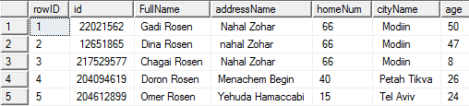
תרגיל כיתה – שימוש בפונקציות
1. נא להוריד את הקובץ Northwind.sql מאתר הקורס.
2. השתמש בטבלת Order Details וכתוב שאילתא המציגה את מחיר
היחידה (UnitPrice) , ואת מחיר היחידה בערכי מספר שלם Integer.
3. השתמש בטבלת EMPLOYEES וכתוב שאילתה המציגה את מספר העובדים
בטבלה.
4. השתמש בטבלת Orders וכתוב שאילתה המציגה את עמודת ביצוע ההזמנה
(OrderDate) , עמודת משלוח (shippedDate), והפרש הזמן בימים בין מועד
ביצוע ההזמנה (OrderDate) למשלוח (shippedDate). קרא לעמודת הפרש
הזמן בשם Duration.
5. כתוב שאילתה הממירה את המחרוזת ' 2018-05-10' לטיפוס מסוג
datetime, והצג את השנה כעמודה בשם: HireDateYear .
6. לפניך טבלת נתונים אישיים.

Slide 19
תרגיל כיתה – שימוש בפונקציות
צור את הטבלה בשם Personal_Details וקלוט לתוכה את הנתונים כפי שהם
מופיעים.
6. כתוב שאילתה המציגה את השם הפרטי כעמודת 'First Name' בנפרד, ואת שם
המשפחה כעמודת 'Last Name' בנפרד מתוך עמודת השם המלא (FullName).
7. החלף את התו רווח (' ') בשם העיר 'Petah Tikva' בתו '_' . השתמש בפונקציה
Replace.
8. הצג את מספר הלקוחות השונים מתוך עמודת EmployeeID הקיימים בטבלת
Orders, ותן שם מתאים לעמודה. שים לב: קיים יותר ממזהה אחד ללקוח
בעמודה.
9. הצג את הנתונים של 10% מהלקוחות הראשונים בטבלת Customers.
10. הצג מטבלת Employees את שם המשפחה והשם הפרטי של העובד בעמודה אחת
כ-'Full Name ' , ותאריך הולדתו של העובד , לעובדים ששנת הולדתם 1963.

